Slide 1
Samples overview
Calibration samples (model building)
Validation samples (model testing)
Prediction samples (Property prediction for further analyses)

Slide 2
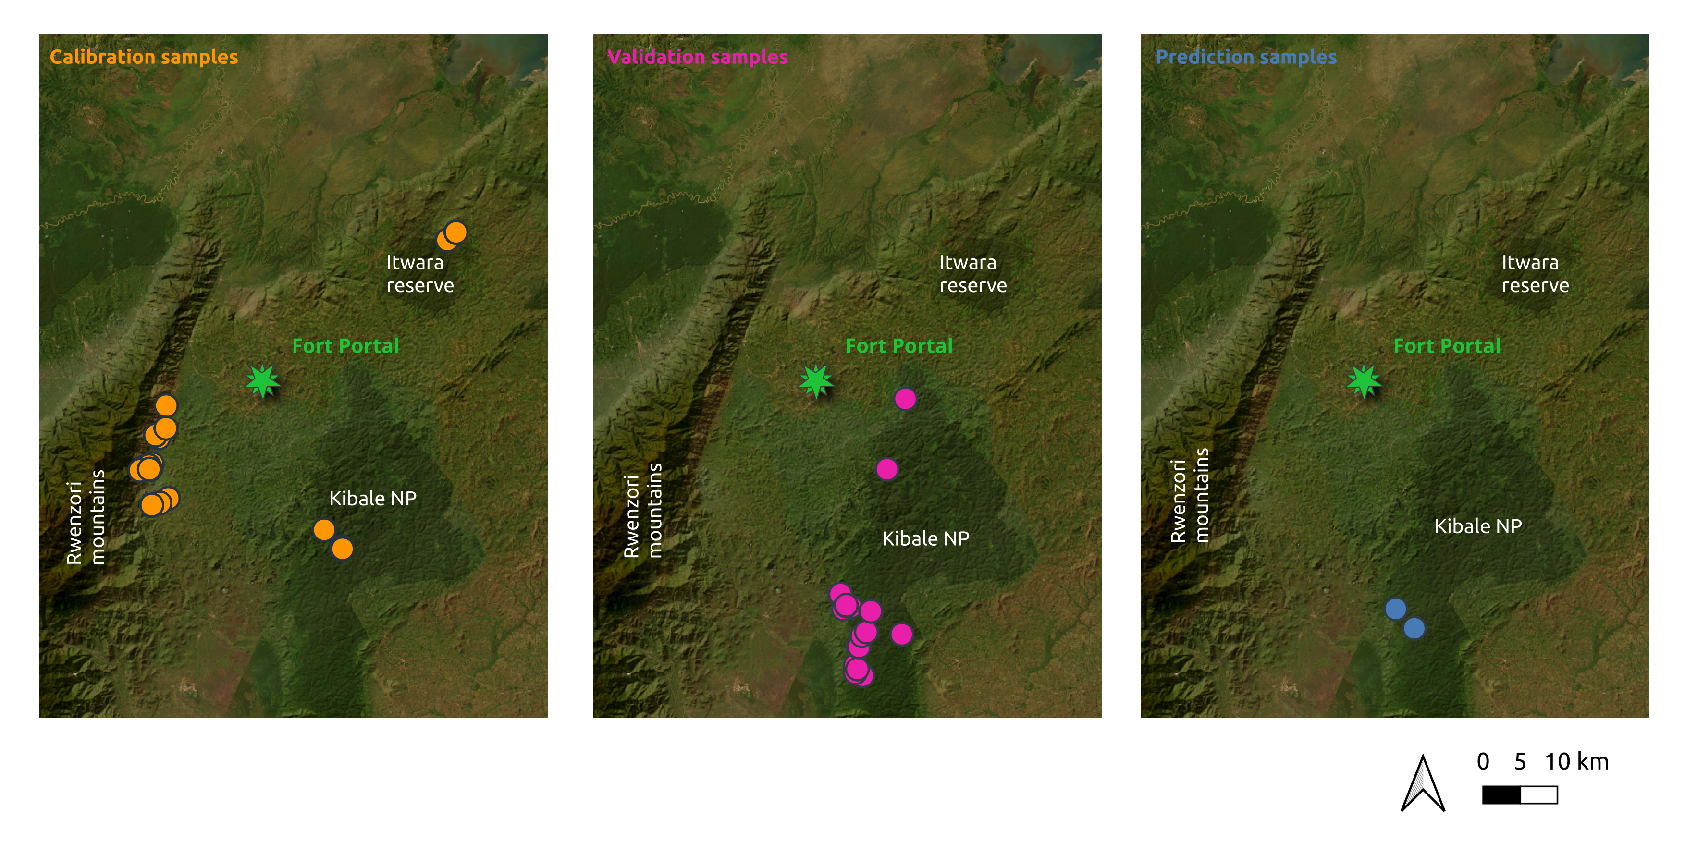
Sample sets / location

Slide 3
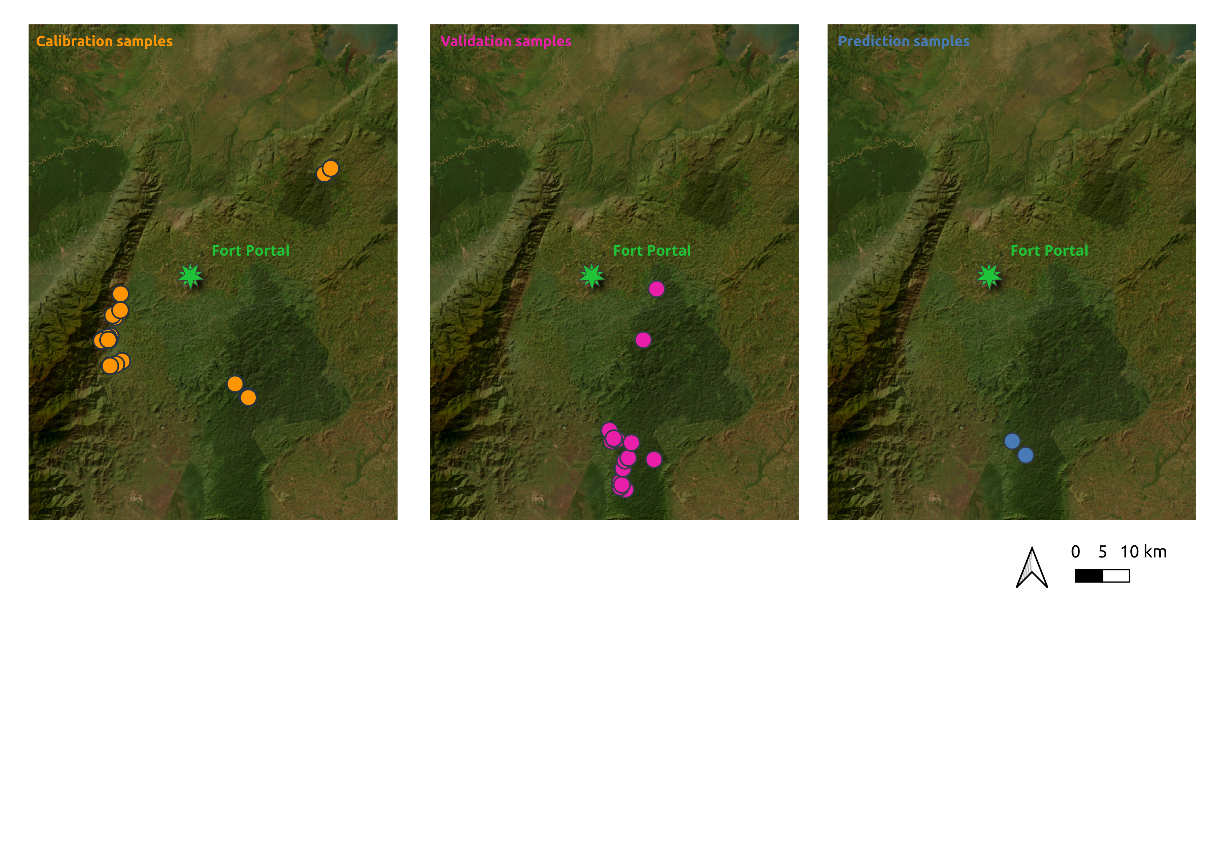
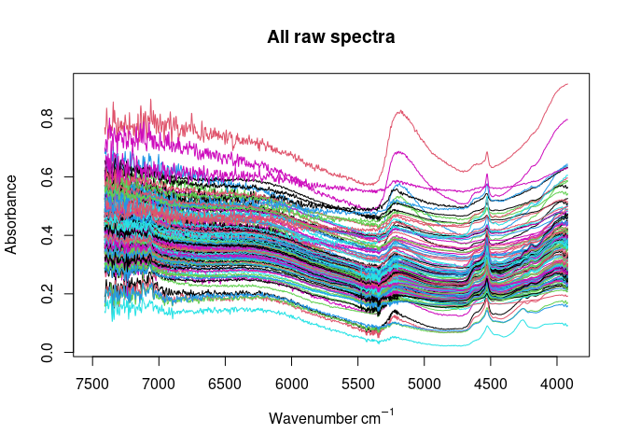
Calibration samples / model building
151 samples with available near-infrared data and paired wet chemistry data (soil organic carbon)
Provide basis for calibration modeling
Sample origin: Rwenzori foothills, Itwara forest reserve, Kibale National Park
Land use: cropland and forest
Infrared spectrometer: Vertex70 BRUKER NIR wavelength range: 1300 – 2550 nm
Wet chemistry method: Dry combustion (CN analyzer)

Slide 4
Validation samples / model testing
19 samples soil organic carbon data
Provide basis for testing of the performance of the established calibration model
Sample origin: Kibale National Park
Land use: forest
Infrared spectrometer: need to be measured
Wet chemistry method: Dry combustion (CN analyzer)

Slide 5
Prediction samples
20 samples without any data
Need to be analyzed for subsequent data analyses
Sample origin: Two contrasting soil cores from Kibale National Park
Land use: forest
Infrared spectrometer: need to be measured

Slide 6
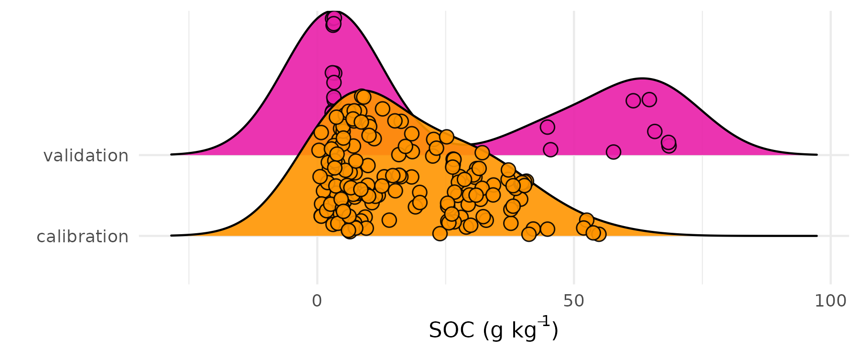
Reference data (SOC data)
Calibration set: 0.3 – 54.9 g SOC kg⁻¹ dry soil
Validation set: 2.9 – 68.5 SOC kg⁻¹ dry soil

